Slide 1
Effect of Delay on the Stability of a Coupled Reactor-Flash System Sustaining an Elementary Non-isothermal Reaction
Anish Pophale - CH20B012
Kamaleshan D G - CH20B055

Slide 2
Introduction
In a typical chemical industry, a reactor is coupled with a separator downstream so that a recycle stream rich in the unreacted reactant can be fed back to the reactor upstream.
Hence , the reactor and separator unit are coupled by the recycle stream and changes in any one of them affects the other.
Therefore, it is important to study the stability and dynamics of such processes as it is undesirable to operate the system using process variables which may lead to unstable steady states.
Along with this, we will also consider the effect of transportation delay from the reactor to the separator - The fluid leaving the reactor with a given concentration does not instantaneously reach the separator.

Slide 3
Objective of the work
We will be taking the example of a non isothermal CSTR coupled with an isothermal and isobaric flash.
The reactor and separator are coupled both by mass as well as energy but here, we will consider only the effect of mass coupling.
The stability and dynamic analysis without the effect of delay will be first considered.
The main objective is to study changes occurring in the stability of the steady states when the effect of transportation delay from the CSTR to the flash column is considered.
We will consider the effect of delay in the transportation from the reactor effluent to the flash column while neglecting the delay in the recycle stream.

Slide 4
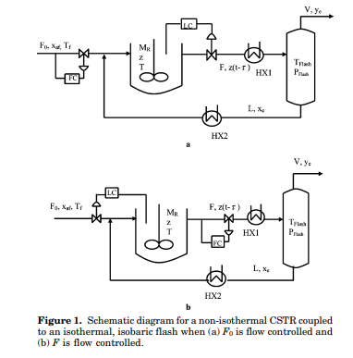
Description of the system
The system consists of a non isothermal CSTR, coupled with an isothermal and isobaric flash downstream along with two heat exchangers as shown below with an elementary first order reaction.
The heat exchanger HX1 is used to bring the temperature of the reactor effluent stream to the flash temperature.
Similarly the heat exchanger HX2 is used to change the temperature of the recycle stream from the flash temperature to the reactor feed temperature.
In this way, the temperature of the reactor and separator are independent and the two units are hence energetically decoupled.
This will allow us to study only the effect of mass coupling.
Two cases of this system will be considered –
Molar holdup (M_{R}) and fresh feed flow rate (F₀) is fixed while the reactor effluent flow rate (F) is controlled.
Molar holdup (M_{R}) and reactor effluent flow rate (F) is fixed while the fresh feed flow rate (F₀) is controlled.

Slide 5
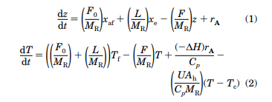


Model equations
The species mole balance and energy balance for the CSTR is given as:
The total and species mole balance for the flash column is given as:
As there is no accumulation of moles in the entire system, we get:

Slide 6
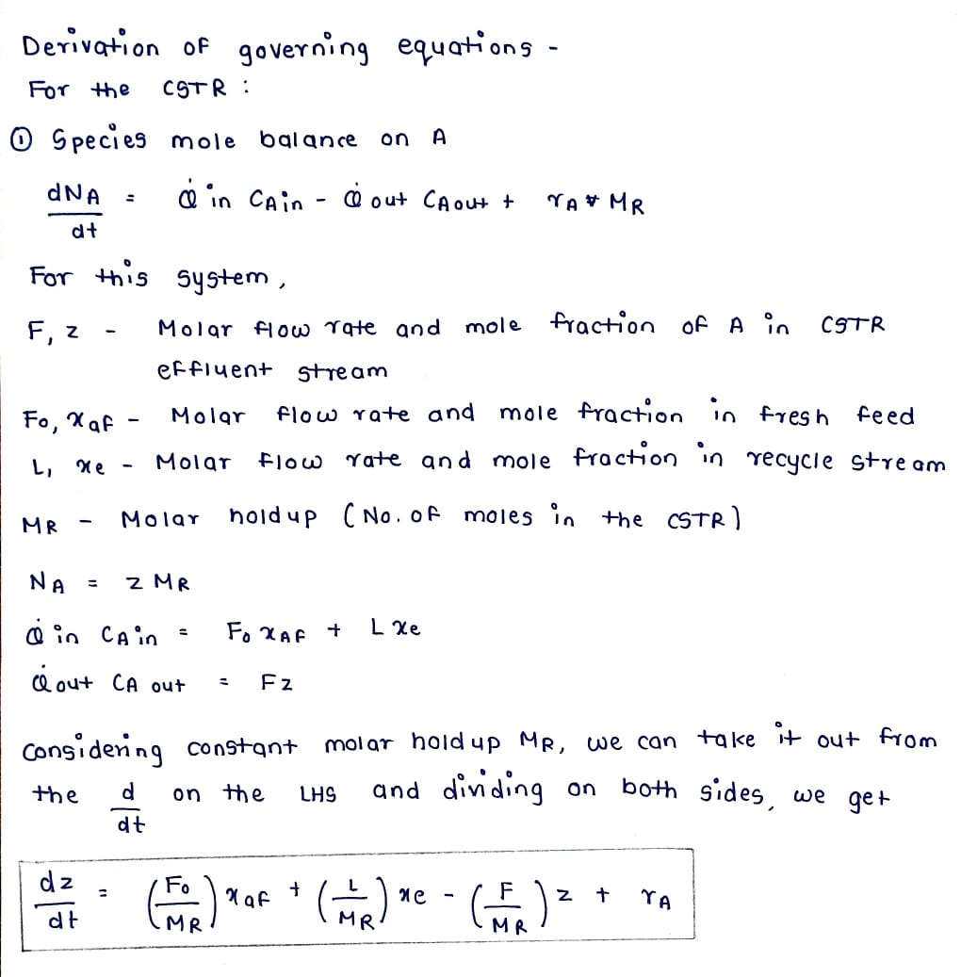
Model equations
The derivation of these equations is given as follows:
Species Mole balance in CSTR

Slide 7
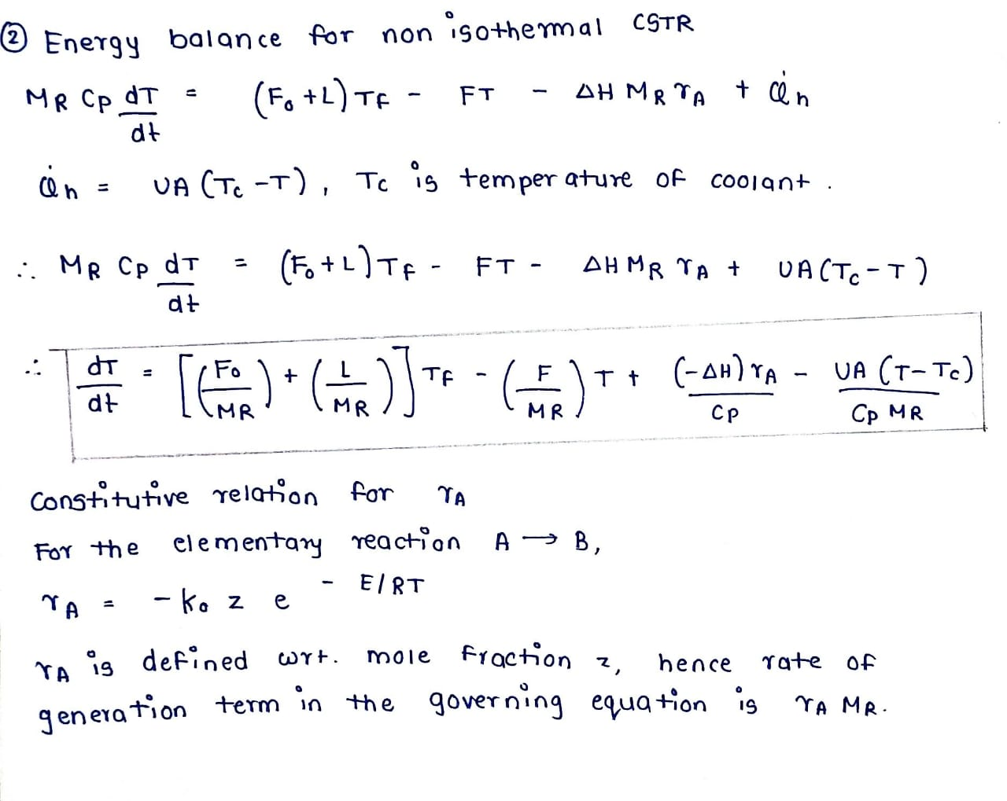
Model equations
Energy balance for non isothermal CSTR

Slide 8
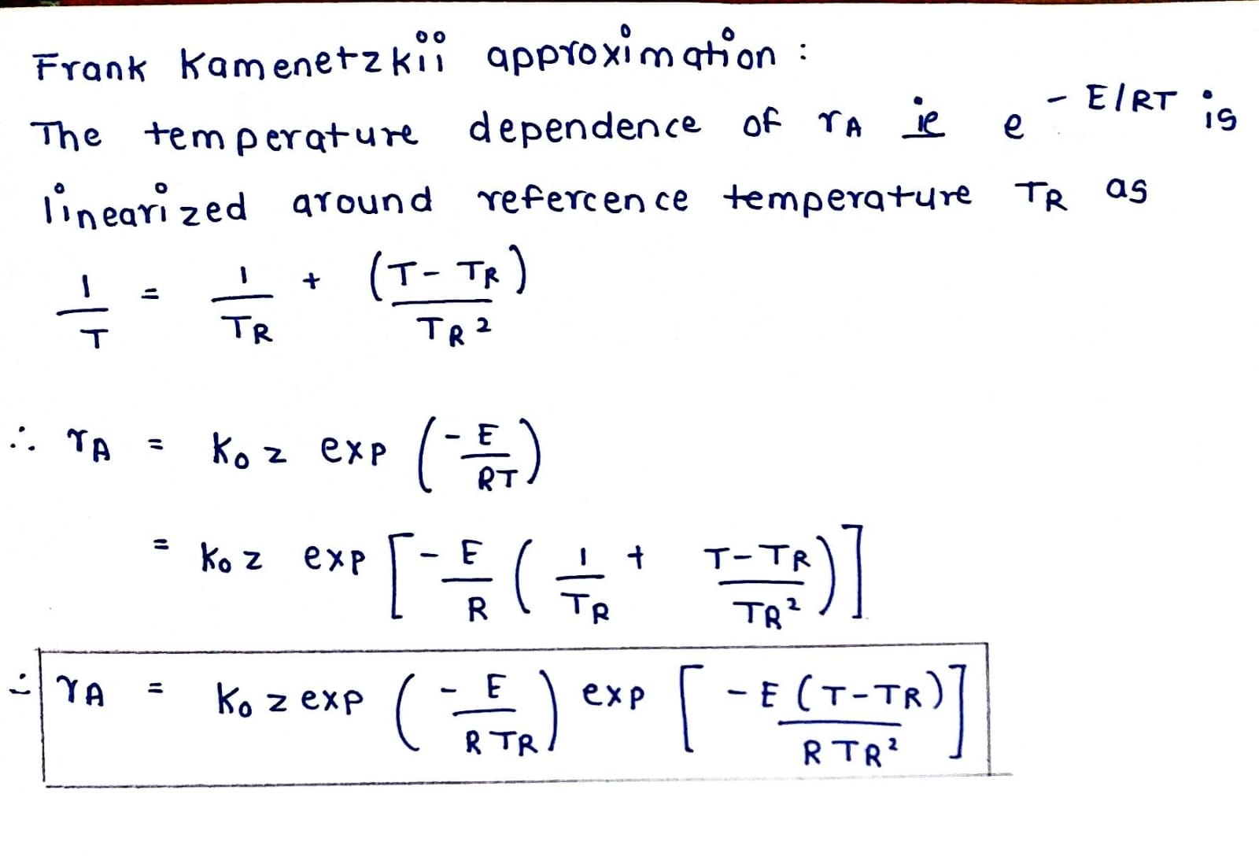
Model equations
Frank Kamenetzkii Approximation -
For the temperature dependence of the rate, we will linearize the Arrhenius equation with respect to a reference temperature as below.

Slide 9
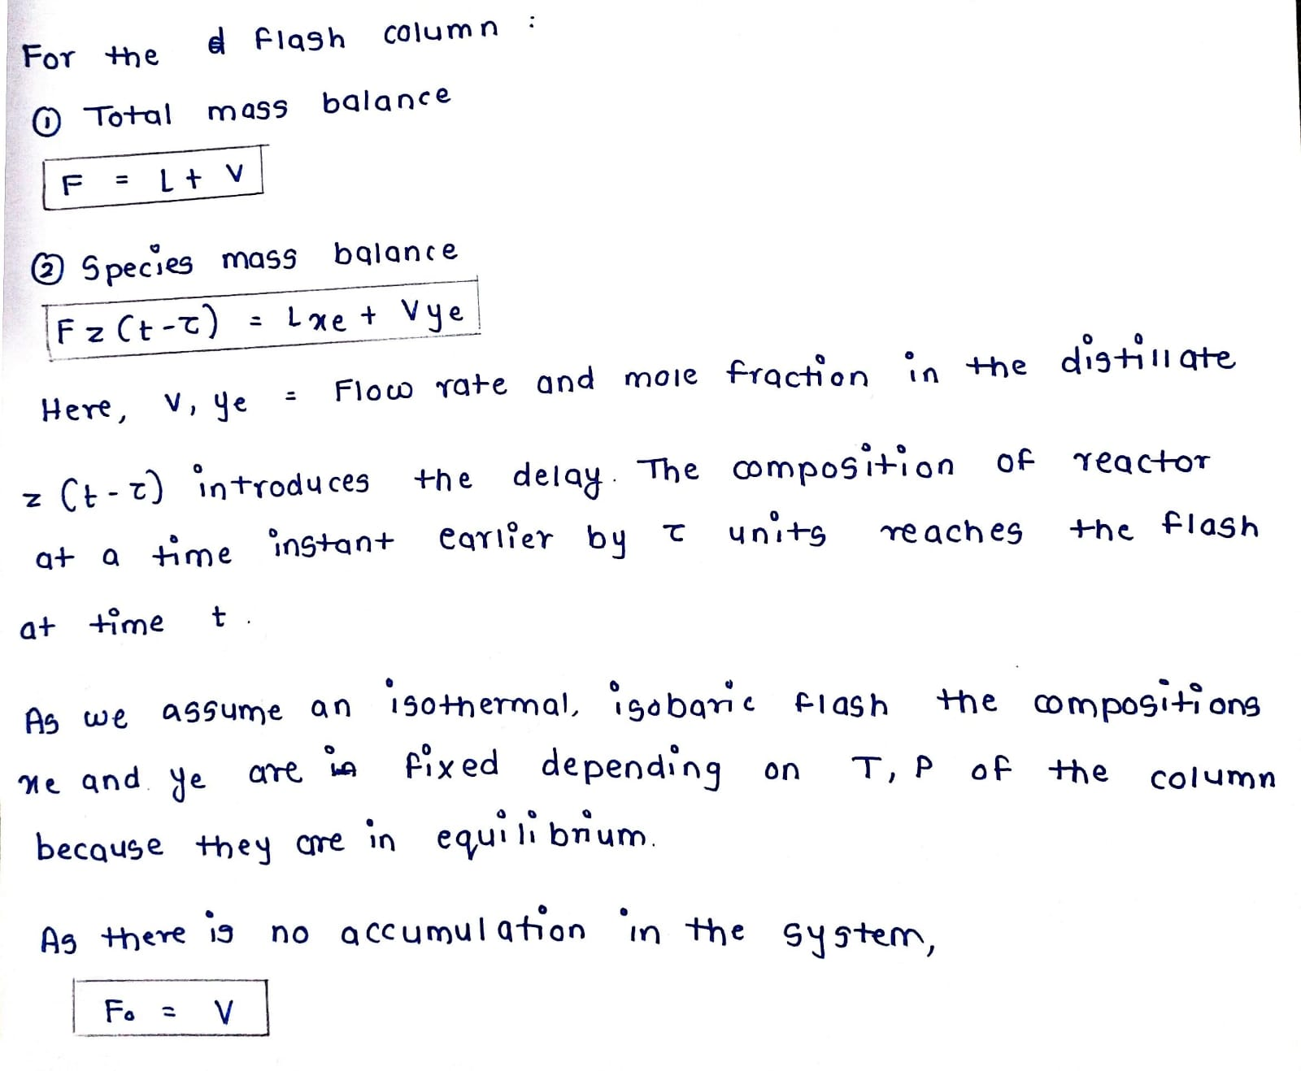
Model equations
Species and total mole balances on the flash column

Slide 10
Degree of Freedom Analysis
We have 5 equations and one constitutive relation for the temperature dependence of the reaction rate.
X_{af}, T_{f}, T_{flash}, P_{flash}, M_{R} are fixed. As the streams exiting the flash column are assumed to be in equilibrium, for fixed T_{flash} and P_{flash}, x_{e} and y_{e} are also fixed.
Hence there are 6 independent variables - z ,T ,F ,F₀ ,L ,V.
Number of model equations = 5.
Therefore, DOF = 1 and hence we can specify one of the 6 variables which leads to the two cases which we will be analyzing further -
Fixed M_{R} and F₀
Fixed M_{R} and F
The governing equations in these cases can be simplified and converted to a non dimensional form as follows

Slide 11
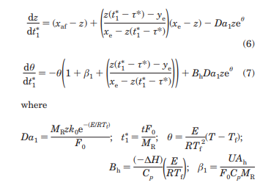
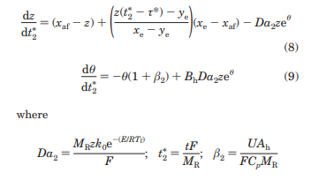
Dimensionless governing equations
Case 1: Fixed M_{R} and F₀
In this case, the variables F, V, L can be eliminated using equations 3-5 and F in terms of F₀ can be substituted in equations 1 and 2.
The equations obtained can be non dimensionalized as follows using the dimensionless variables given.
Case 2: Fixed MR and F
In this case, the variables F₀, V, L can be eliminated using equations 3-5 and F₀ in terms of F can be substituted in equations 1 and 2.
The equations obtained can be non dimensionalized as follows using the dimensionless variables given.

Slide 12
Details of the simulation
Case 1: Fixed M_{R}, F₀
The parameters used for the simulation are:
X_{af} = 1
Y_{e} = 0.1
X_{e} = 0.9
B_{h} = 8.8
β₁ = 4.0
Case 2: Fixed M_{R}, F
The parameters used for the simulation are:
X_{af} = 0.9
Y_{e} = 0.2
X_{e} = 0.8
B_{h} = 14.0
β₂ = 4.2
In case 1, Da1 which depends on F₀ and in case 2, Da2 which depends on F are varied for the bifurcation analysis.

Slide 13
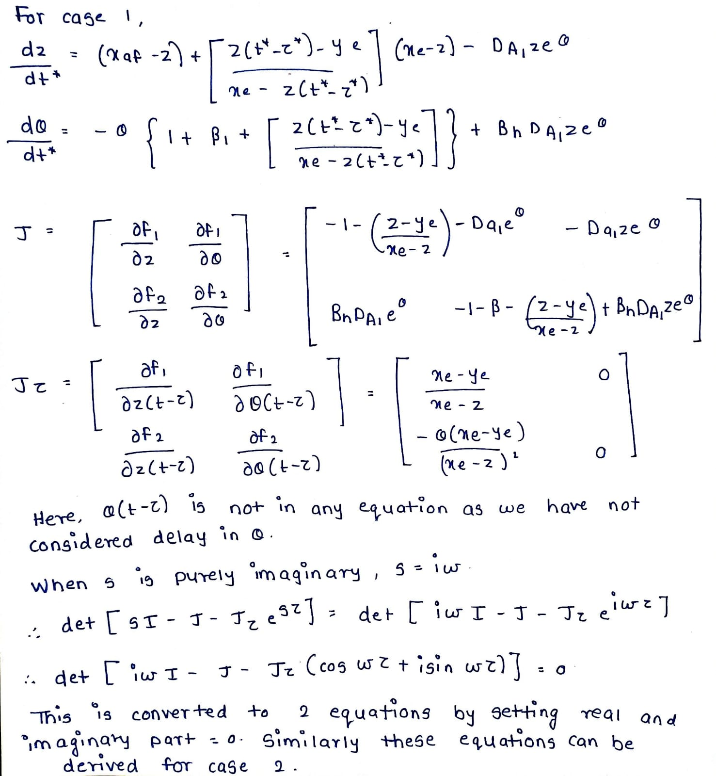
Details of the simulation
For the linear stability analysis of the delay differential equations, we use the following method:
The characteristic equation to find the eigen values is given as det(sI – J – J_{τ}e^{sτ} ) = 0
If we consider that the real part of s = 0, we can get the value of τ critical for which the system shows a transition in stability.
Here, J is the Jacobian w.r.t the normal variables and J_{τ} is the Jacobian w.r.t to the delayed variables evaluated at the steady state.
Sample calculations to derive the Jacobians and the characteristic equation are shown for case 1 which can be repeated for case 2 as well.

Slide 14
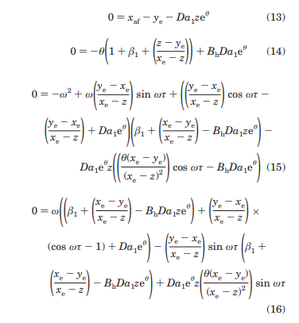
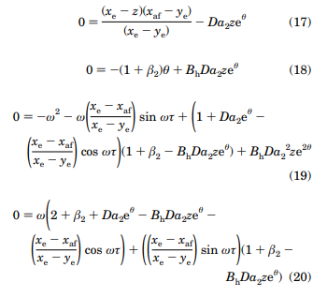
Details of the simulation
These two equations along with the steady state equations can be solved to find the critical τ for a given value of Da for both the cases.
The equations for the linear stability analysis derived by this method for are as follows:
To simulate the dynamic response of the system with delay, the governing equations are a system of delay differential equations which are solved using the dde23 function in MATLAB.

Slide 15
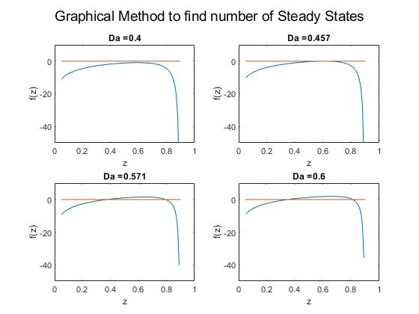
Results
Case 1: Fixed M_{R}, F₀
Linear Stability analysis without delay:
The variable θ was eliminated from the two model equations at SS to get a single equation in terms of only z which has been plotted as f(z) vs z to find the number of steady states which occur as f(z) = 0.
There is no steady state for Da1<0.457
There is only one steady state at Da1 = 0.457 beyond which there are 2 SS for every Da1.

Slide 16
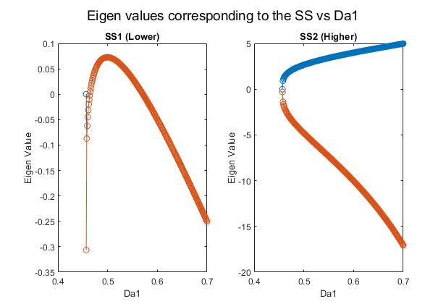
Results
Case 1: Fixed M_{R}, F₀
Linear Stability analysis without delay:
For SS2, one eigen value is positive and the other is negative for all Da1, so the higher steady state is always unstable.
For SS1, except for at Da1 = 0.457, the eigen values become complex with the same real part for both eigen values, hence we get only one curve.
When 0.464 < Da1 < 0.571, both eigen values are positive and hence the SS1 is also unstable, otherwise it is stable.

Slide 17
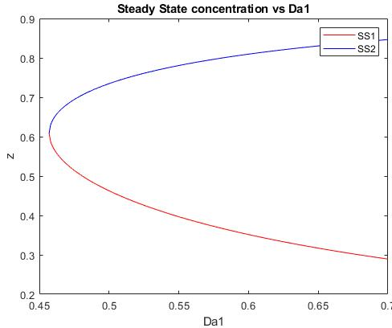
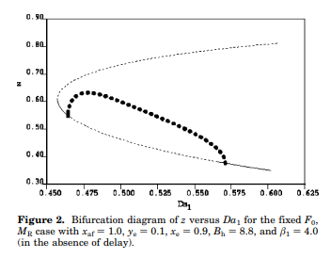
Results
Case 1: Fixed M_{R}, F₀
Bifurcation diagram without delay:
From the analysis of eigen values, we can see that for 0.464 < Da1 < 0.571 both the steady states are unstable.
For other values of Da1, SS1 is stable while SS2 is unstable.
This is also seen in the plot to the right where the dotted lines show the unstable SS and solid lines show stable SS.

Slide 18
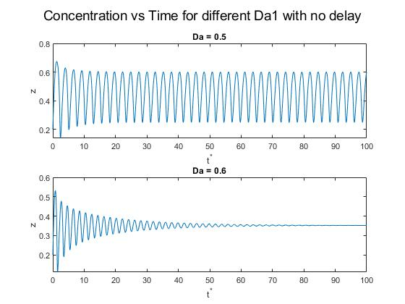
Results
Case 1: Fixed M_{R}, F₀
Dynamic analysis without delay :
For Da1 = 0.5, we know that there is no stable SS and hence we get the oscillations.
For Da1 = 0.6, only SS1 is stable and the system reaches SS1 as shown.

Slide 19
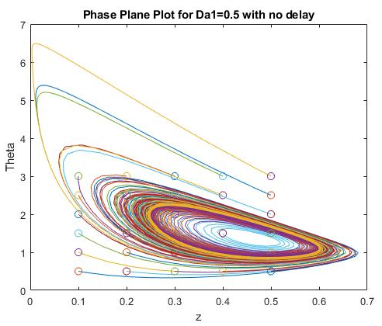
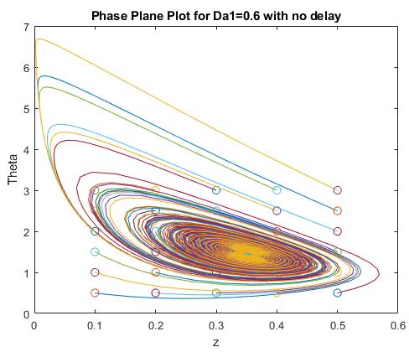
Results
Case 1: Fixed M_{R}, F₀
Phase Plane plots without delay:
This again shows the previous result that a SS is attained for Da1 = 0.6, not for Da1 = 0.5.

Slide 20
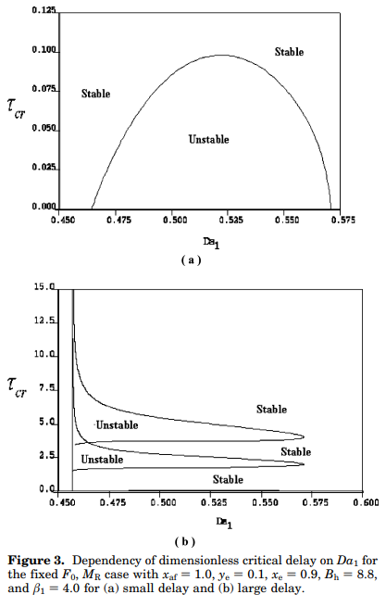
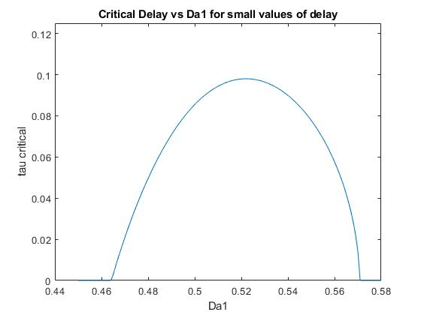
Results
Case 1: Fixed M_{R}, F₀
Bifurcation diagram with delay:
Depending on the value of the delay, we have different regions of stability as shown in the plot on the right. Below the critical delay, the system in unstable and beyond the critical delay, it is stable.
As the delay increases, for small values the width of the region of dynamic instability decreases.

Slide 21
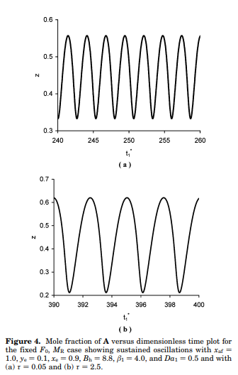
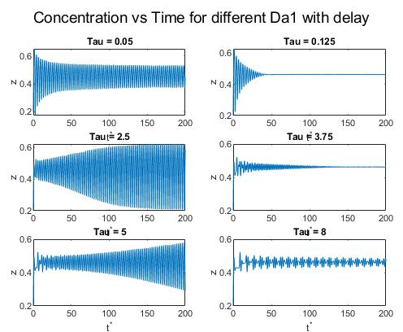
Results
Case 1: Fixed M_{R}, F₀
Dynamic analysis with delay:
As shown, the stability is now dependent on the delay.
The plots are shown for Da1 = 0.5 which lead to 2 unstable SS in the case without delay and the stability changes with delay which is also seen from the bifurcation diagram.
For this case if we consider a isothermal CSTR, the stability becomes independent of the delay.

Slide 22
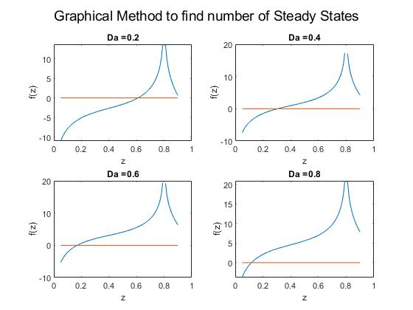
Results
Case 2: Fixed M_{R}, F
Linear Stability analysis without delay:
The variable θ was eliminated from the two model equations at SS to get a single equation in terms of only z which has been plotted as f(z) vs z to find the number of steady states which occur as f(z) = 0.
In this case, there is only one steady state for all values of Da2.

Slide 23
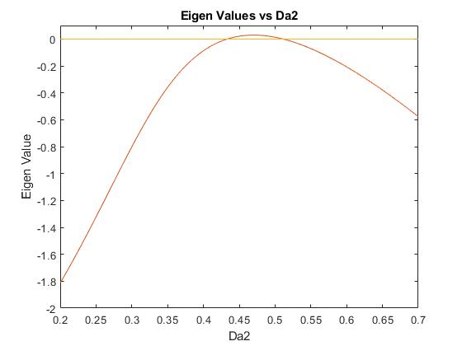
Results
Case 2: Fixed M_{R}, F
Linear Stability analysis without delay:
Here, both the eigen values for the SS are imaginary with equal real parts, hence we get only one curve.
It can be seen that for 0.433 < Da2 < 0.511, both eigen values are positive and so the SS is unstable.
For other values of Da2, both the eigen values are negative and we get a stable SS.

Slide 24
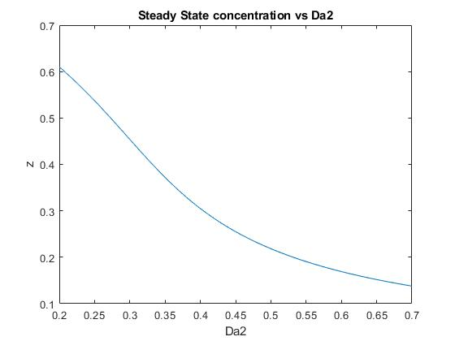
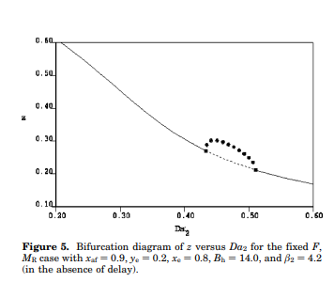
Results
Case 2: Fixed M_{R}, F
Bifurcation diagram without delay:
From the analysis of eigen values, we can see that for 0.433 < Da2 < 0.511 the steady state is unstable and for other values, it is stable.
This is also seen in the plot to the right where the dotted lines show the unstable SS and solid lines show stable SS.

Slide 25
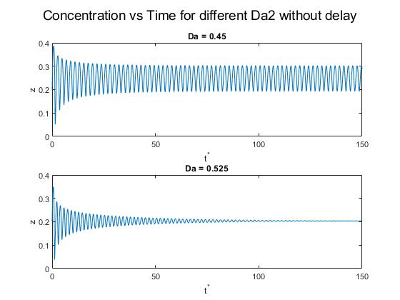
Results
Case 2: Fixed M_{R}, F
Dynamic analysis without delay :
For Da2= 0.45, we know that there is no stable SS and hence we get the oscillations.
For Da2 = 0.525, there is a stable steady state which the system attains as shown.

Slide 26
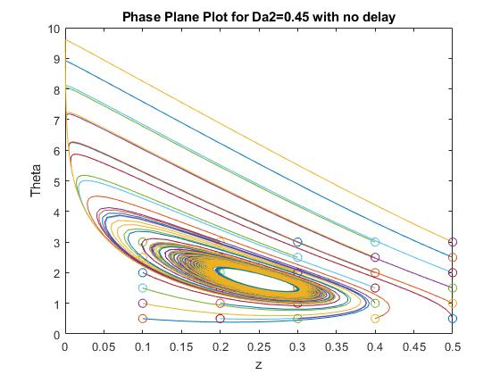
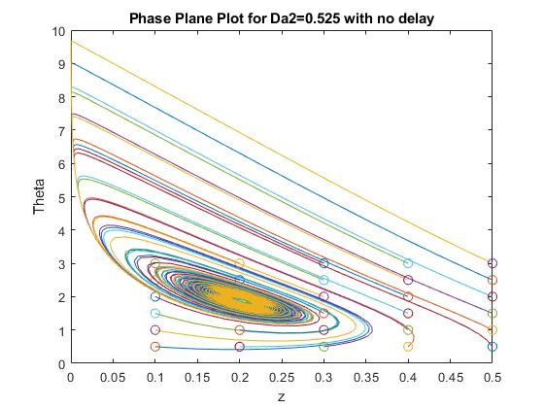
Results
Case 2: Fixed M_{R}, F
Phase Plane plots without delay:
This again shows the previous result that a SS is attained for Da2= 0.525, not for Da2 = 0.45.

Slide 27
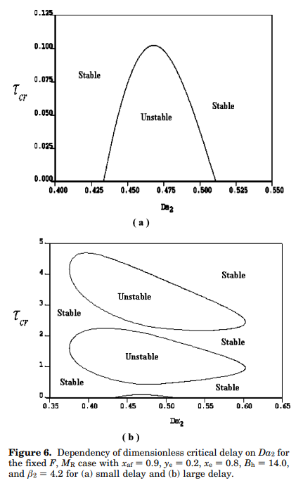
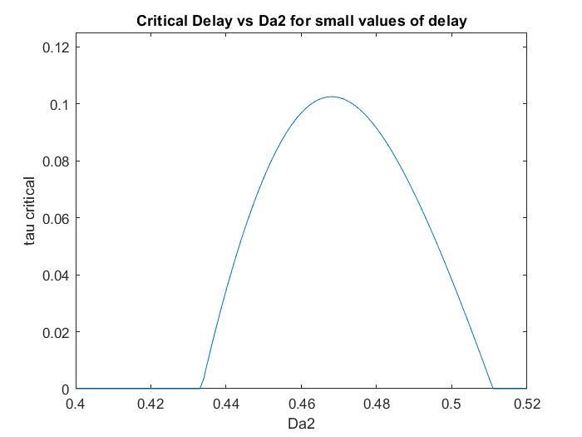
Results
Case 2: Fixed M_{R}, F
Bifurcation diagram with delay:
Depending on the value of the delay, we have different regions of stability as shown in the plot on the right. Below the critical delay, the system in unstable and beyond the critical delay, it is stable.
As the delay increases, for small values the width of the region of dynamic instability decreases.

Slide 28
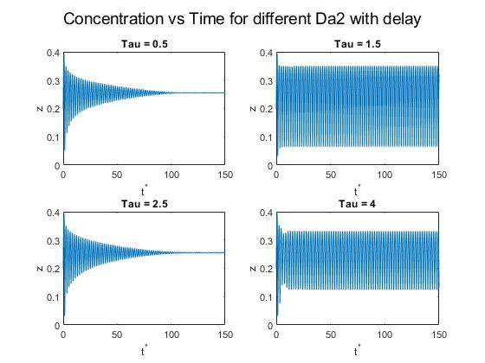
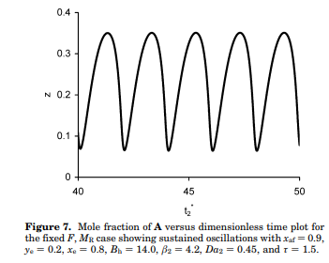
Results
Case 2: Fixed M_{R}, F
Dynamic analysis with delay:
As shown, the stability is now dependent on the delay.
The plots are shown for Da2 = 0.45 which lead to an unstable SS in the case without delay and the stability changes with delay which is also seen from the bifurcation diagram.
For this case if we consider a isothermal CSTR, delay cannot introduce a new instability.

Slide 29
Conclusion
For a non isothermal reactor, the stability of a given steady state of a system changes with the transportation delay in the reactor effluent stream.
For small values of the delay, the width of the region of unstable steady state decreases.
In the case without delay, the instability is an effect of the non linearities in the Arrhenius temperature dependency of the rate.
But in the case with delay, new zones of instability are introduced solely due to the effect of this lag .
Hence, the delay has an significant effect on the stability and dynamics of this non isothermal reactor separator system which needs to be considered while designing process plants.

Slide 30
Extension of the work
A similar analysis can be done considering the effect of temperature coupling between the reactor and separator which we have avoided in this system with the use of two heat exchangers.
The lag in the temperature has also been ignored which can be considered in the model.
The lag in the transport of the recycle stream has been ignored here as the bottoms of the flash column gives an liquid assumed to be incompressible, through which changes in the flow rate are transmitted instantaneously. A new model extending this study can consider this effect as well.
During the oscillations in the region of instabilities, it is observed that z falls below y_{e} which is not possible. This is because at z = y_{e}, the flow rate of the recycle stream is zero and for z < y_{e} the flow rate becomes negative which is not possible. For this a new model can be developed which imposes the condition that L = 0 when z < ye.

